Slide 1

Navjot Multiplication Tables
Khalsa Productions
Navjot Singh x13112406
Soffyan Ali x13114531

Slide 2
Our Project Idea
Our Idea is to promote our own Android application which is available on Play Store.
Using responsive website.
YouTube video.
Interactive Animation.
QR Code.
Facebook and Twitter.
Google Play Store.

Slide 3

Application Statistics
Based on Downloads in a Country.

Slide 4
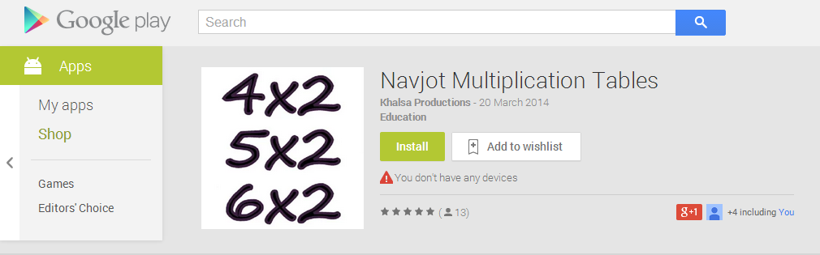
Description
Educational application based on Object Oriented Programming(OOP) which makes it Extra Smart then other similar Multiplication based applications.

Slide 5

Features
Access Multiplication Tables ranging from, 0 to 100 million.
Multiple Screen Support.
Easy to Use (suitable for Kids).
100% ads Free(Non-profit Application).
All device support ranging - 2.1 - 4.4 (Kit Kat).
Rainbow Colours Added that are choose randomly.

Slide 6
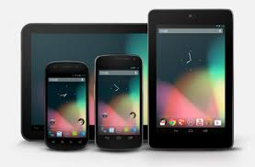
Multiple Screen Size Support
Supports
Tablets
Normal Phones
Small Phones (2.0 and Lower).

Slide 7
Easy and Free
Easy to Use
Enter your desired number
Press Table button
Full multiplication Table for that number is displayed.
Free
100% ads Free(Non-profit Application).
Take less space on RAM.

Slide 8
Why Choose this over others ?
Tables from 0 to 100 million whereas other applications has limited Number of tables available.
Highly Interactive
We don’t sell Ads.
Wide variety of device support.
Free to Install (No hidden Charges – Non-profit).
Easy to Use.
Colourful, so kids can engage for better learning.
Use anytime works for you in seconds.

Slide 9
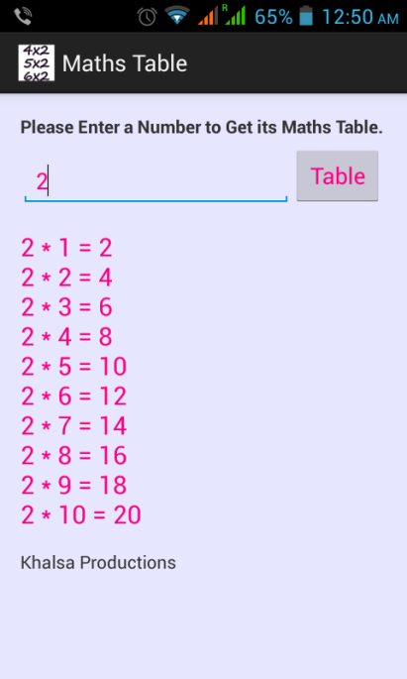
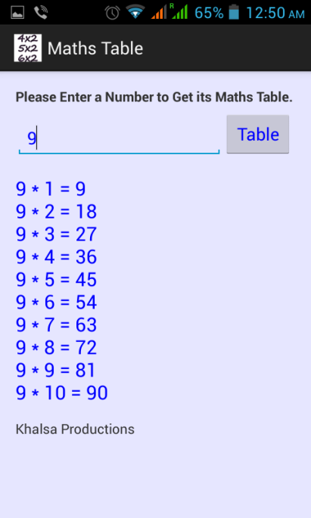
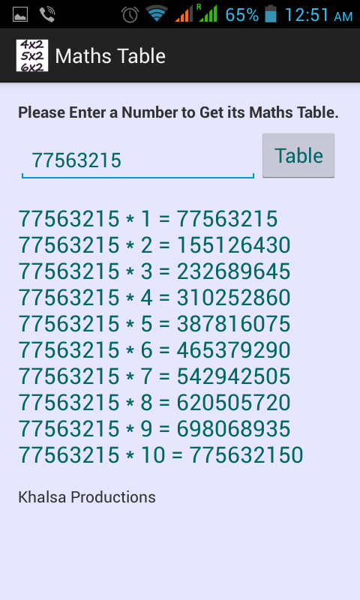
Screenshots
Various Colours that are choose randomly.

Slide 10
Thanks
Please do Install the Application to Get the Features.
Navjot Multiplication Tables
Any Questions ?

